Slide 1

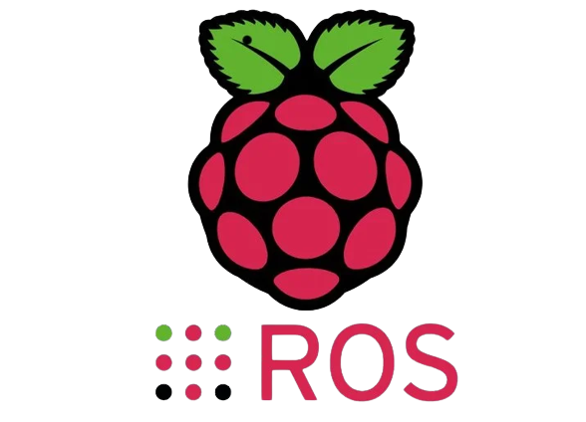

Introduction to Robotics

Slide 2
Agenda
Types of robots
Robotics Applications
Technologies used in Robotics
Linux installation
ROS Installation

Slide 3
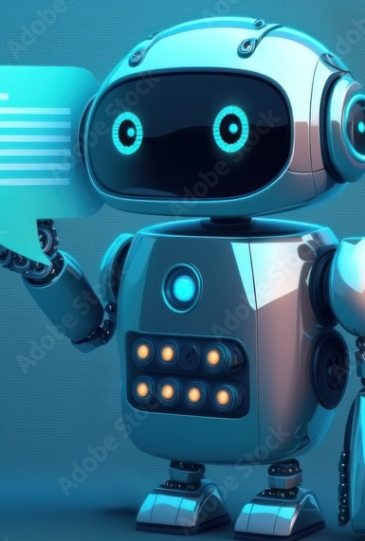
Software robots
also known as software bots, are computer programs designed to automate repetitive and rule-based tasks, mimicking human actions within digital systems. They excel at tasks like data entry, form filling, and report generation, reducing errors and increasing operational efficiency. Software robots can integrate with various applications, scale up easily, and offer cost savings through labor reduction.
These bots are often part of Robotic Process Automation (RPA), where they play a pivotal role in streamlining business processes and freeing up human resources for more complex, value-added tasks. RPA tools facilitate the configuration and management of software robots, making automation accessible and adaptable to a wide range of industries and functions.

Slide 4
Common types of hw robots
Automated Guided Vehicles (AGVs)
Autonomous Mobile Robots (AMRs)
Underwater Robots (ROVs and AUVs)
Articulated Robots
Humanoid
Cobots
Hybrid

Slide 5

Non-fixed vs fixed
Mobile | Stationary
AMRs AGVs Humanoids Hybrids | Articulated robots Cobots

Slide 6
Robotics applications
Industrial
Farming and Agriculture
Logistics
Retail and Hospitality
Smart Cities
Health care

Slide 7
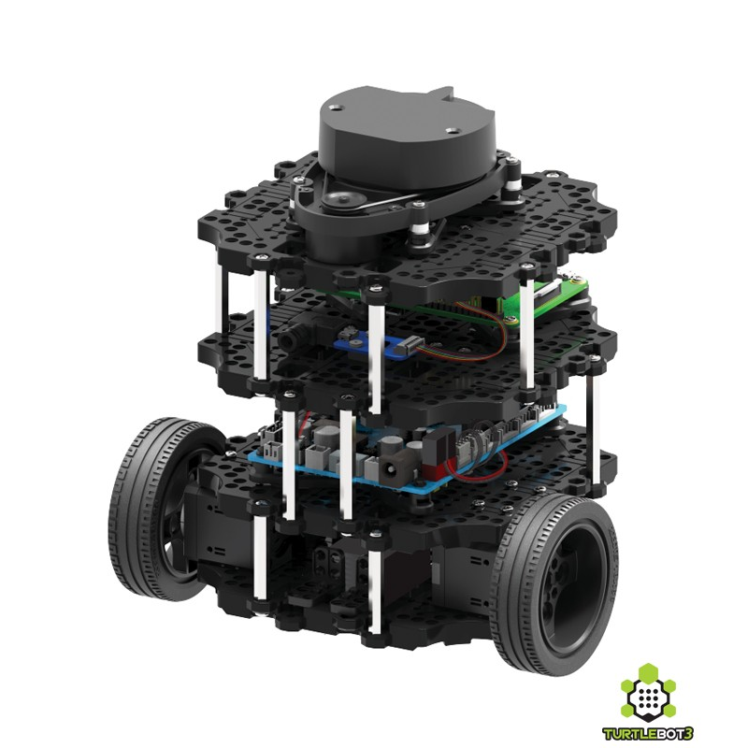
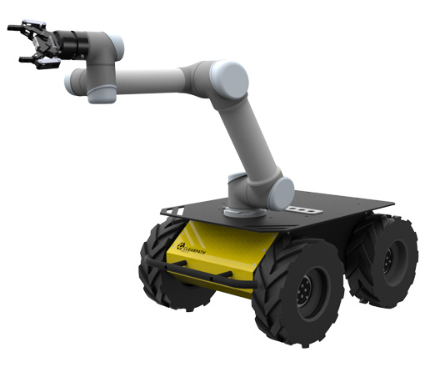
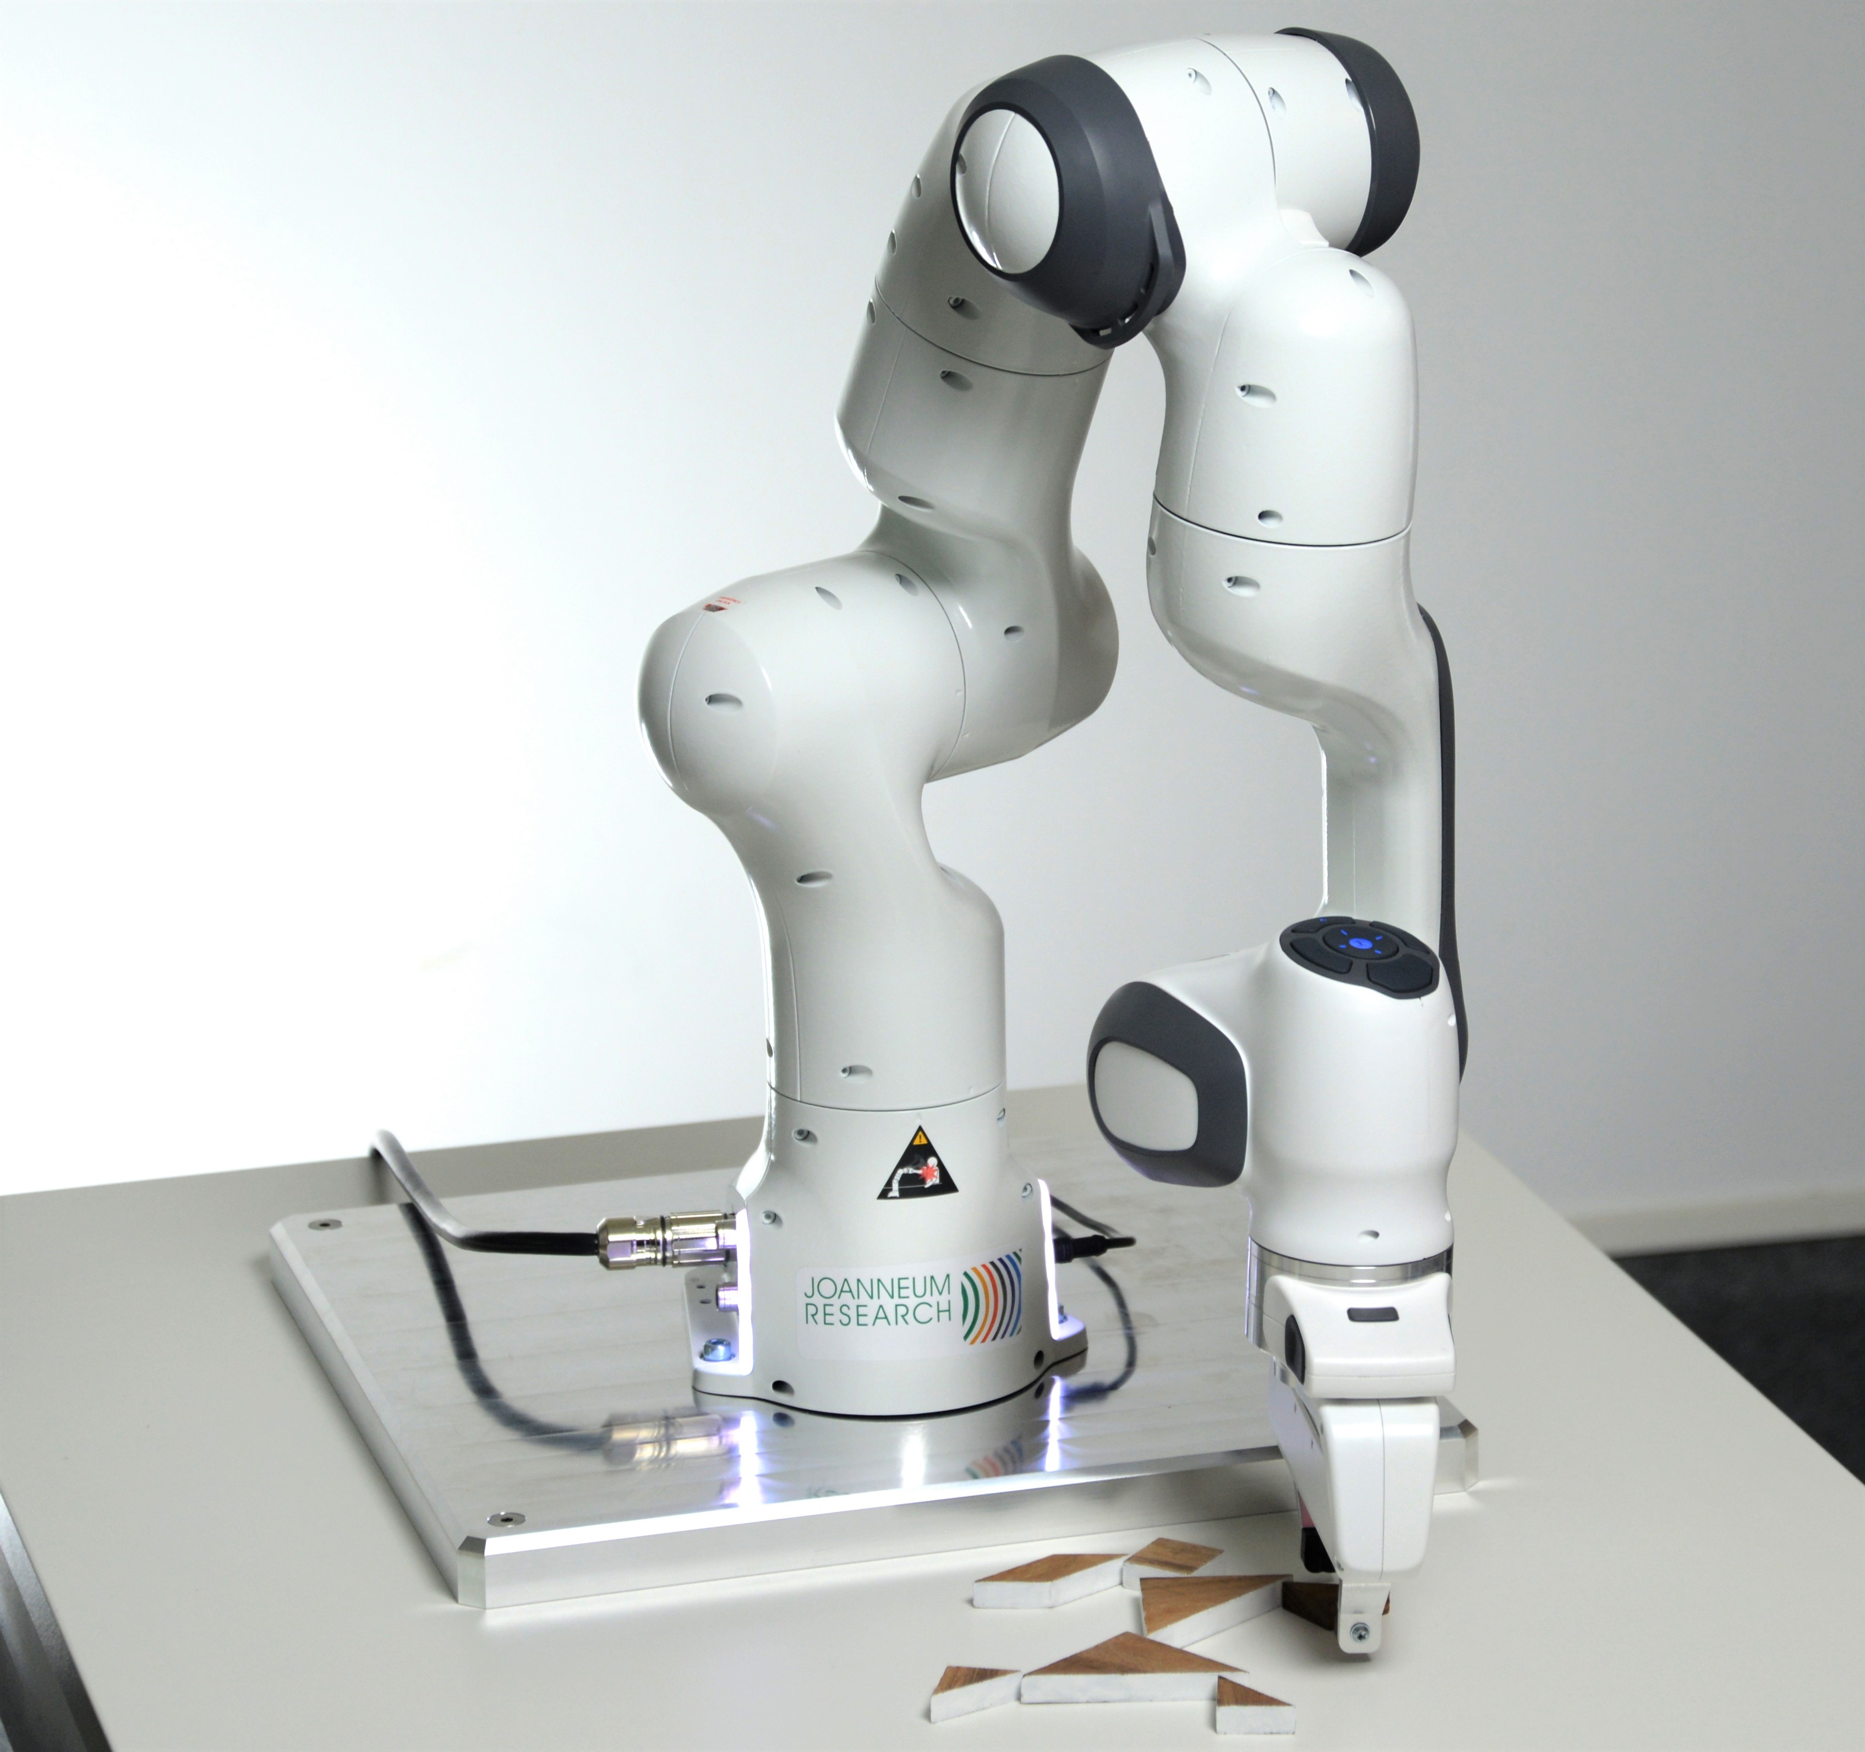
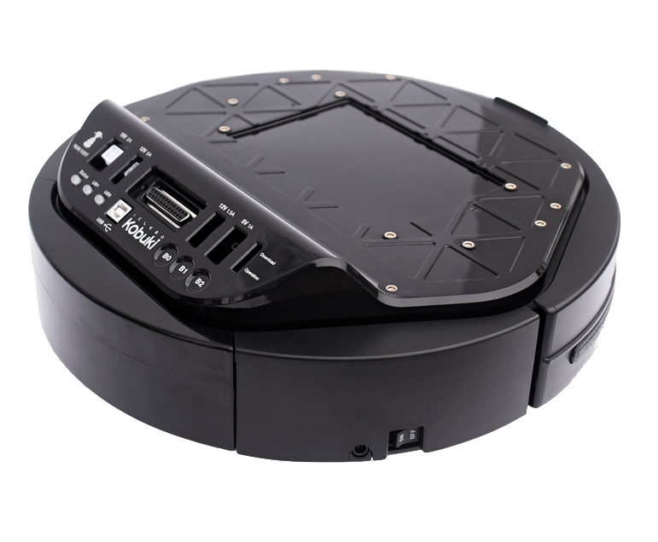
Robots in ros
examples of robots that are compatible with ROS (Robot Operating System) Turtlebot3 , Husky, Franka emika and Kobuki and there a lot more.

Slide 8
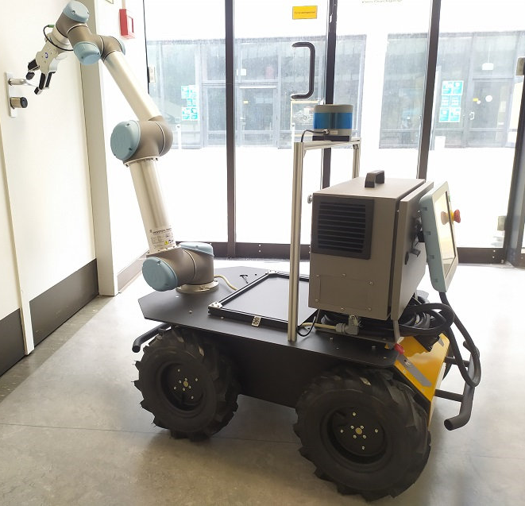
A Smart city project with husky
2 x depth cameras
1 x 3D LiDAR
1 x IMU
1 x u-blox 7 GPS
API: ROS, C++ and python for more info visit: https://www.generationrobots.com/blog/en/a-smart-city-project-with-husky/

Slide 9
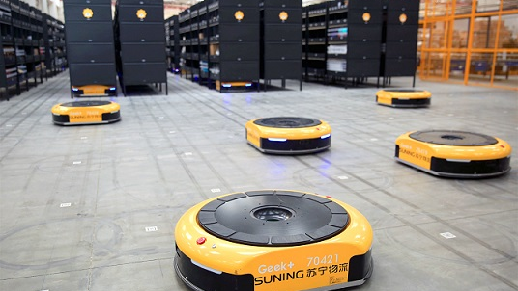
Logistics robots
These robots play essential roles in streamlining and optimizing the movement of goods within warehouses, distribution centers, and transportation hubs. Here are several types of robots used in logistics more than 2 billion dollars' worth robots used in 2022.
Used by Companies which has large warehouses such as Amazon.

Slide 10

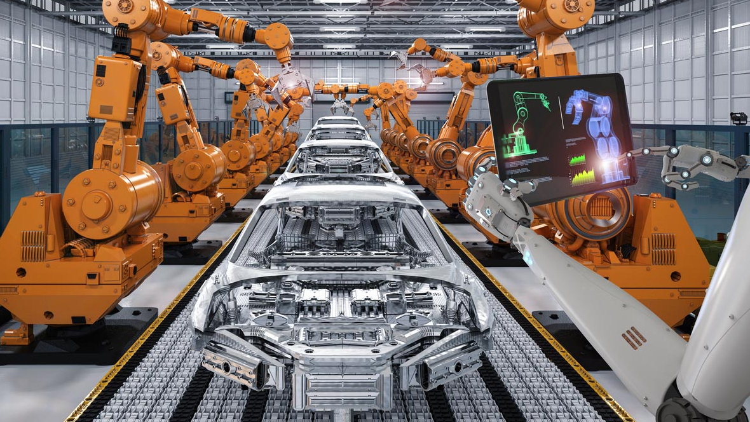

Industrial robots
Industrial robots play key role in Industry 4.0 transformation
Kuka is a famous manufacture for such robots and these robots can be simulated and controlled/automated/programmed by ros
It may involve industrial internet of things (iiot) protocols to control or monitor these robots.

Slide 11
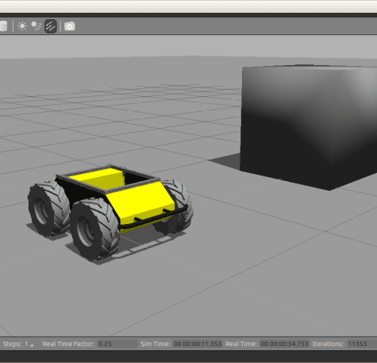
Tools needed to model a robot
Robotics Simulation Software:
Robotics simulation software allows you to create a virtual environment in which you can model the robot's physical characteristics, sensors, and behaviors. Popular robotics simulation platforms include:
Gazebo: An open-source robotics simulator that can simulate the dynamics of a wide range of robots and environments.
Webots: A versatile robotics simulation platform that supports various robot models and programming languages.
V-REP (CoppeliaSim): A multi-platform simulation software with a user-friendly interface and support for modeling complex robotic systems.

Slide 12
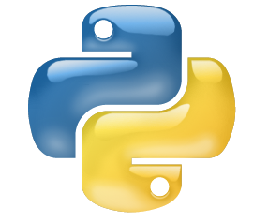

Programming Environment
you'll need a programming environment to develop the robot's control algorithms. Common frameworks used in robotics modeling include:
ROS (Robot Operating System): A flexible framework for writing robot software that provides communication tools and libraries for various robotic tasks.
ROS has two interface programming languages:
C++: Often used for high-performance robot control software.
Python: A popular programming language for developing robot control algorithms and scripts.

Slide 13
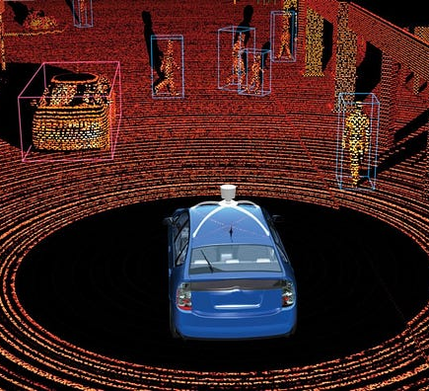
Self-Driving car as a robot example
Self-driving car is a robot which is able to navigate and steer autonomously and the level of human interaction depends on level of autonomy.

Slide 14
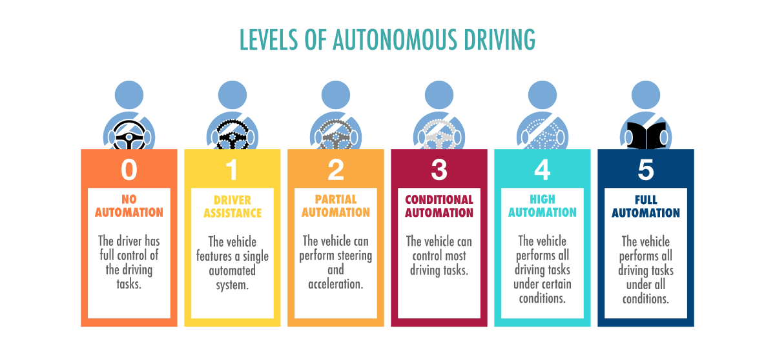
Autonomous vehicle stack

Slide 15
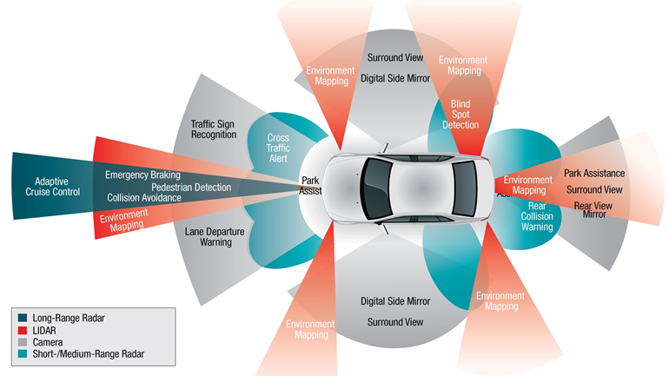

Slide 16
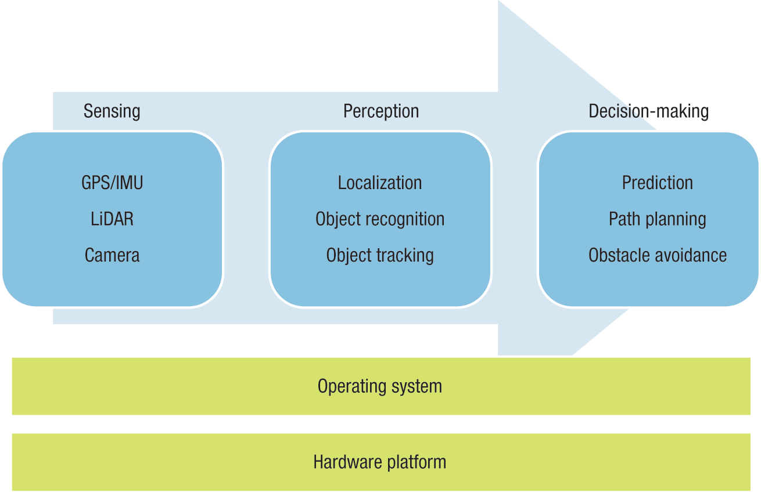
Autonomous driving stack

Slide 17
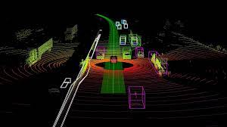
3D Depth Perception
3D Depth Perception: Some robots use stereo cameras or depth-sensing cameras like LiDAR (Light Detection and Ranging) to perceive the depth of objects in their environment. This 3D depth perception enables precise distance measurements and helps robots create accurate 3D maps of their surroundings.

Slide 18
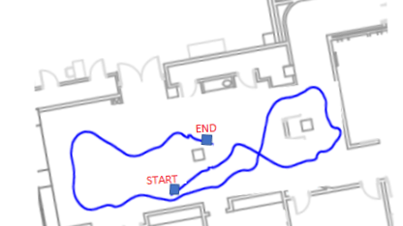
Localization and mapping
Localization refers to the process of determining a robot's position (often represented as a set of coordinates) within its environment. It answers the question: "Where is the robot?" Accurate localization is crucial for robots to move safely, avoid obstacles, and reach their intended destinations. There are various methods for robot localization:

Slide 19
Localization methodology
Odometry: Odometry uses information from wheel encoders or sensors to estimate the robot's position based on the distance and direction it has traveled. Over time, errors can accumulate in odometry-based localization, so it is often used in conjunction with other methods.
Sensor Fusion: This approach combines data from multiple sensors, such as GPS, IMU (Inertial Measurement Unit), lidar, and cameras, to improve localization accuracy. Sensor fusion algorithms, like Kalman filters and particle filters, are commonly used to integrate sensor data and estimate the robot's pose (position and orientation).
SLAM (Simultaneous Localization and Mapping): SLAM is a technique that allows a robot to simultaneously build a map of its environment and determine its own location within that map. It is particularly useful in unknown or dynamically changing environments. SLAM algorithms use sensor data, such as lidar or depth cameras, to create a map and estimate the robot's pose.

Slide 20
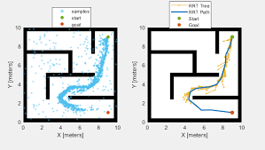
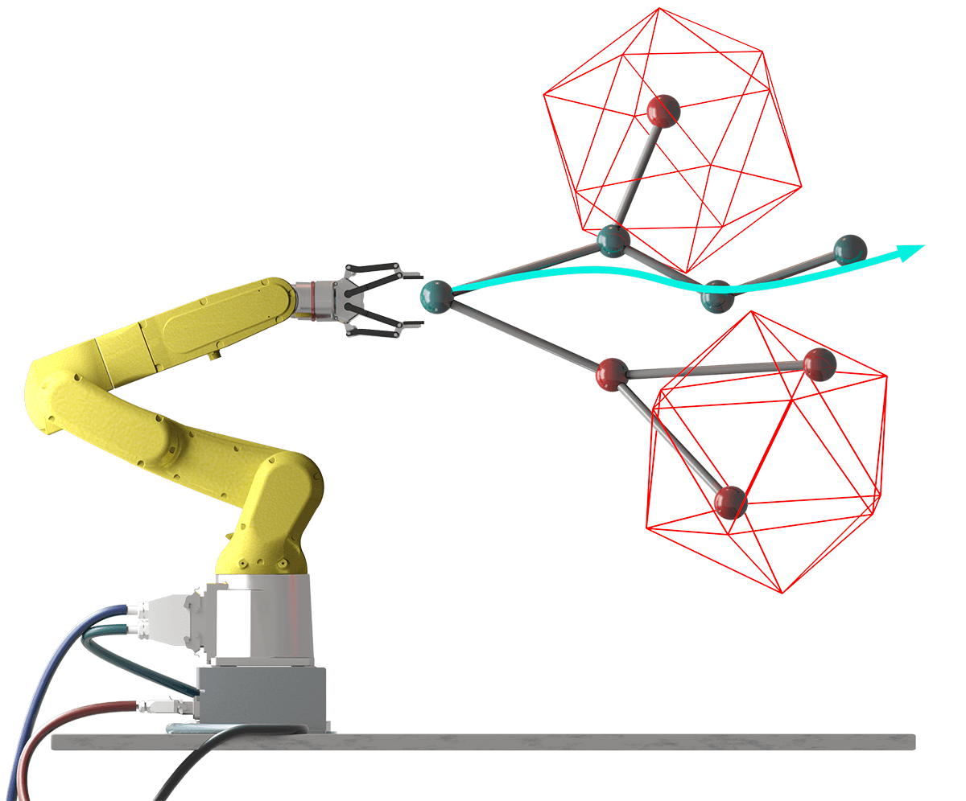
Motion planning
Motion Planning and Control Libraries: You'll need libraries and tools for motion planning and control to simulate how the robot navigates and interacts with its environment. ROS provides various packages for these purposes, such as MoveIt! for motion planning.

Slide 21
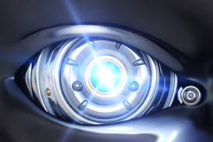
Vision for robots
Many applications involves computer vision for Robotics such as :
Visual Perception: Robots equipped with cameras can capture images or video of their environment. Computer vision algorithms are then used to process this visual data, extracting meaningful information about the surroundings. Visual perception enables robots to "see" and interpret the world in a way similar to how humans do.

Slide 22
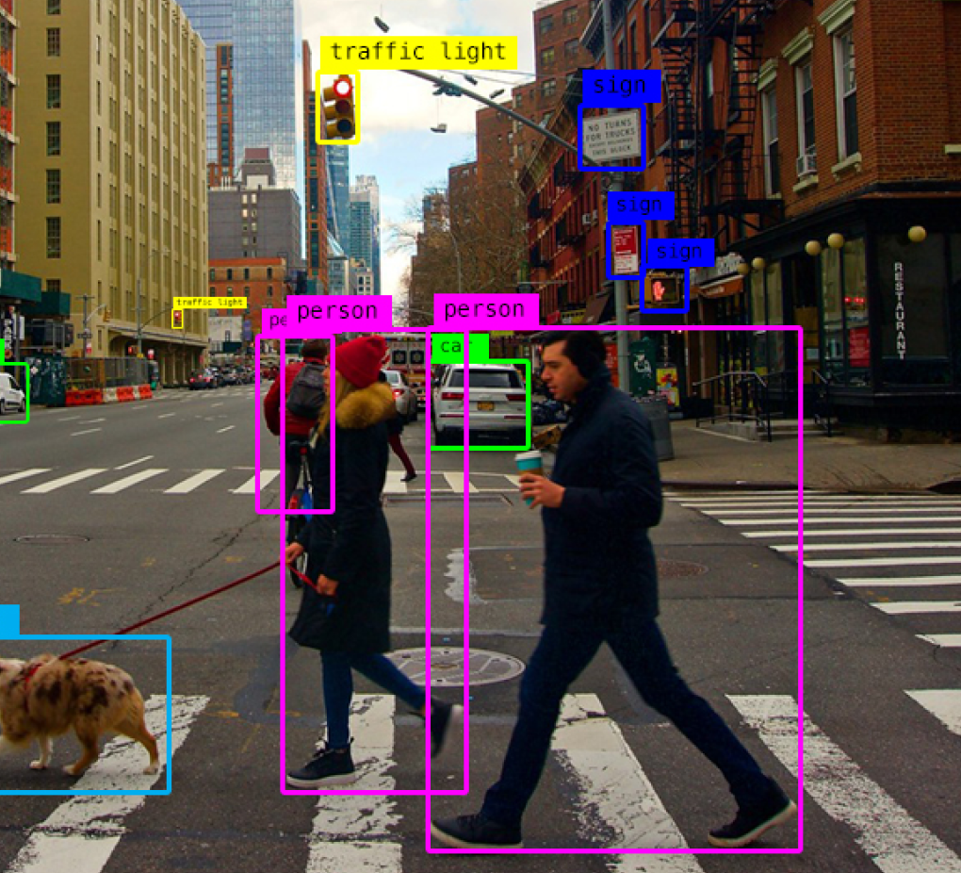
Obstacle Detection and Avoidance
Object Detection and Recognition: One of the primary uses of cameras on robots is to detect and recognize objects. This includes identifying and classifying objects based on their shape, color, texture, or other visual features. Object detection and recognition are essential for tasks such as pick-and-place operations in manufacturing, autonomous navigation, and even assisting in search and rescue missions.
Cameras on robots can be used to detect obstacles in their path. This is crucial for autonomous navigation, as robots can analyze the visual data to plan safe routes and avoid collisions. This capability is particularly important in applications like self-driving cars and warehouse robots.

Slide 23
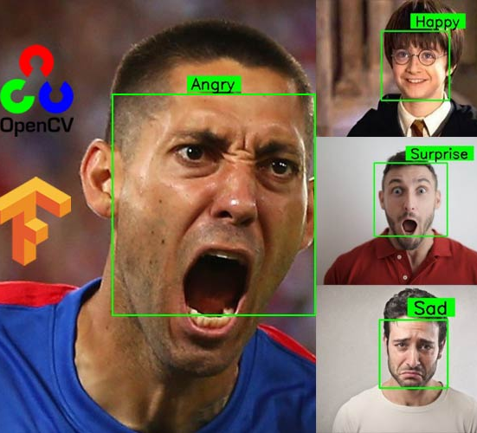
Gesture and Emotion Recognition
In human-robot interaction scenarios, cameras can be used to capture and interpret gestures, facial expressions, and emotions. This allows robots to respond to human cues and signals, making interactions more natural and intuitive.

Slide 24

Technologies used in vision
OpenCV is a library for computer vision made by intel and its widely used nowadays in various and many Computer vision and Robotics Applications and it has many programming languages interfaces such as C++, Java and Python. C++ is used when you are targeting high-performance applications used in industry.

Slide 25
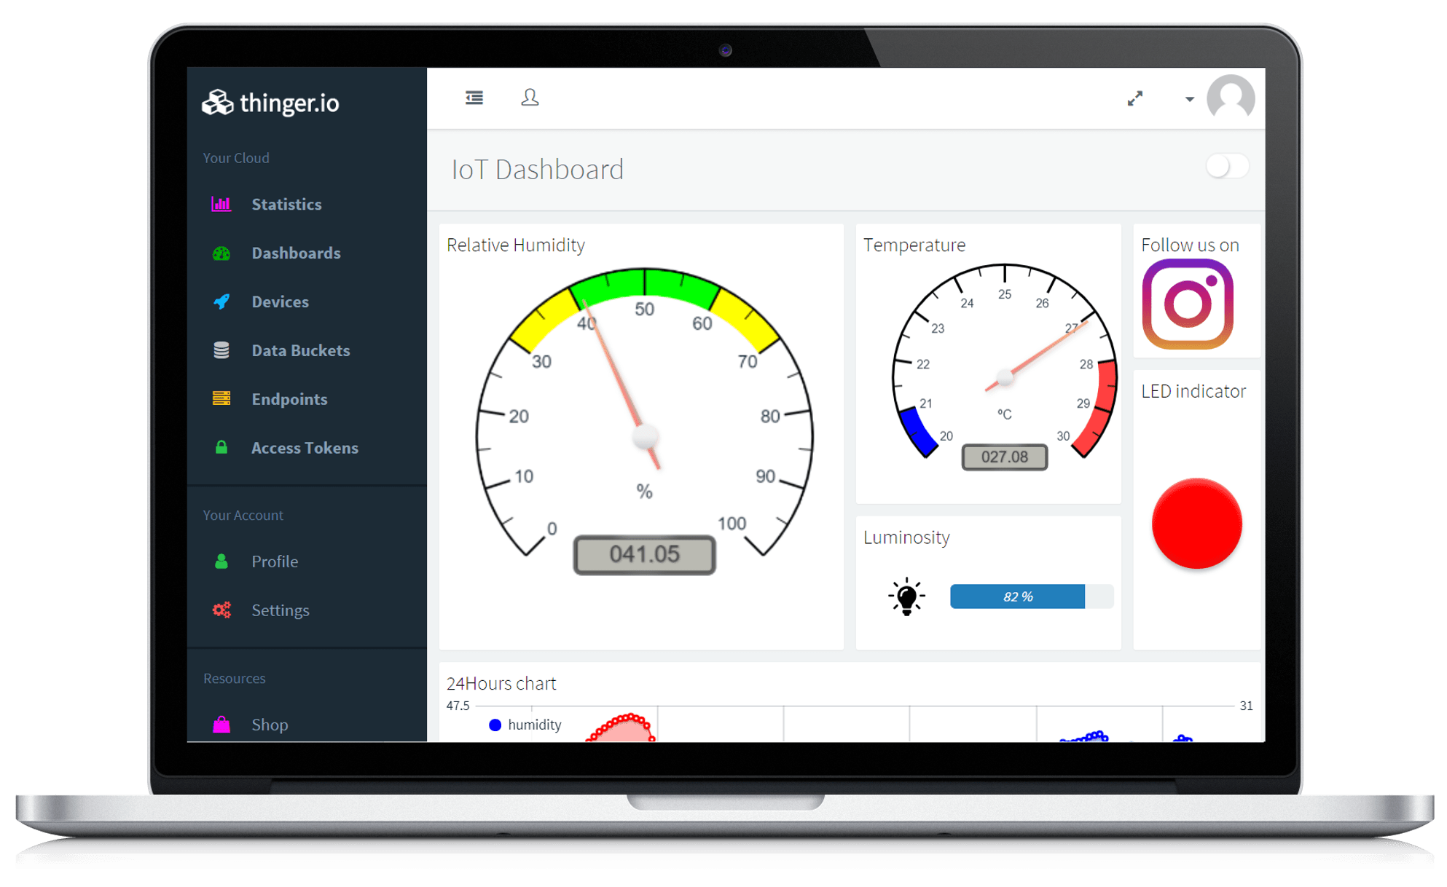
Robots and internet of things
IoT is used in Robotics to accomplish one or both of the following tasks :
Control
Monitor
Could be like giving a set point as a destination to reach for an autonomous mobile robot
Or could be these AMR is equipped by sensors to monitor the environment for example a robot to monitor the weather status and sends sensor readings to a remote server.

Slide 26
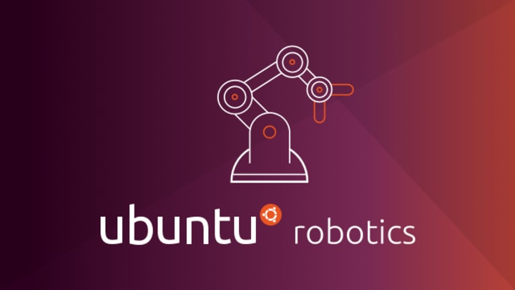
Let's get started
Install Ubuntu and ROS

Slide 27
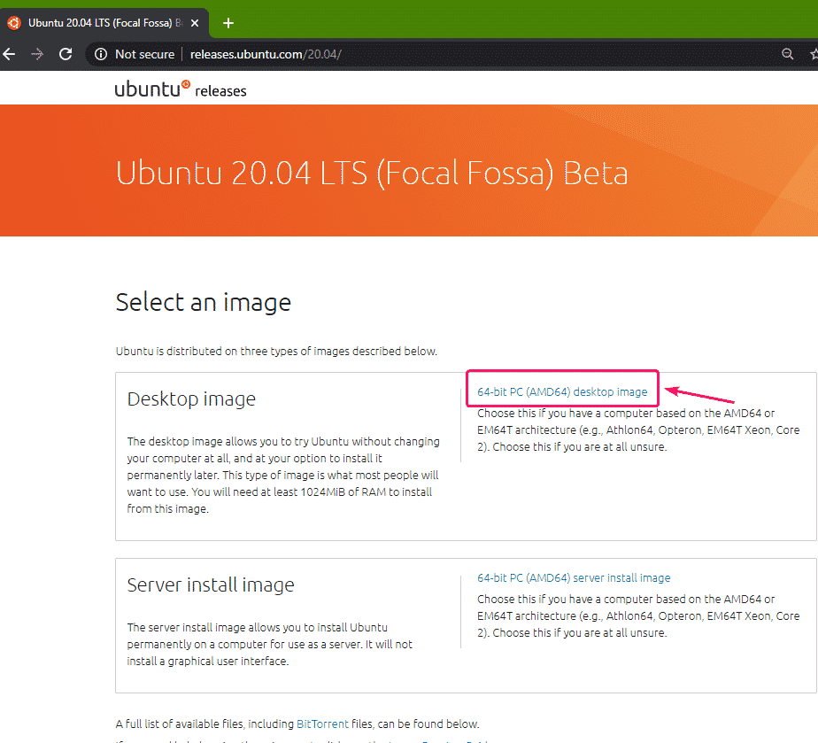
Download ubuntu 22.04
Select the 20.04 release

Slide 28
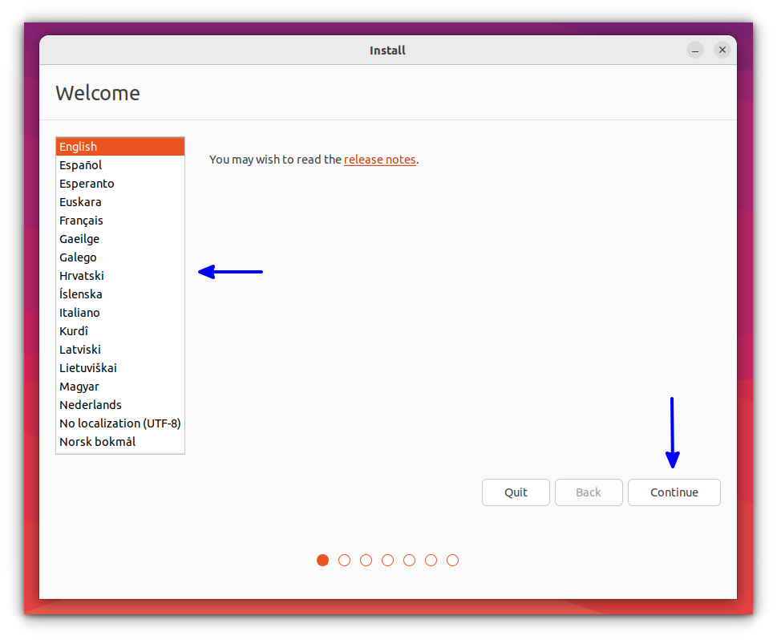
Select lang.
English then continue

Slide 29
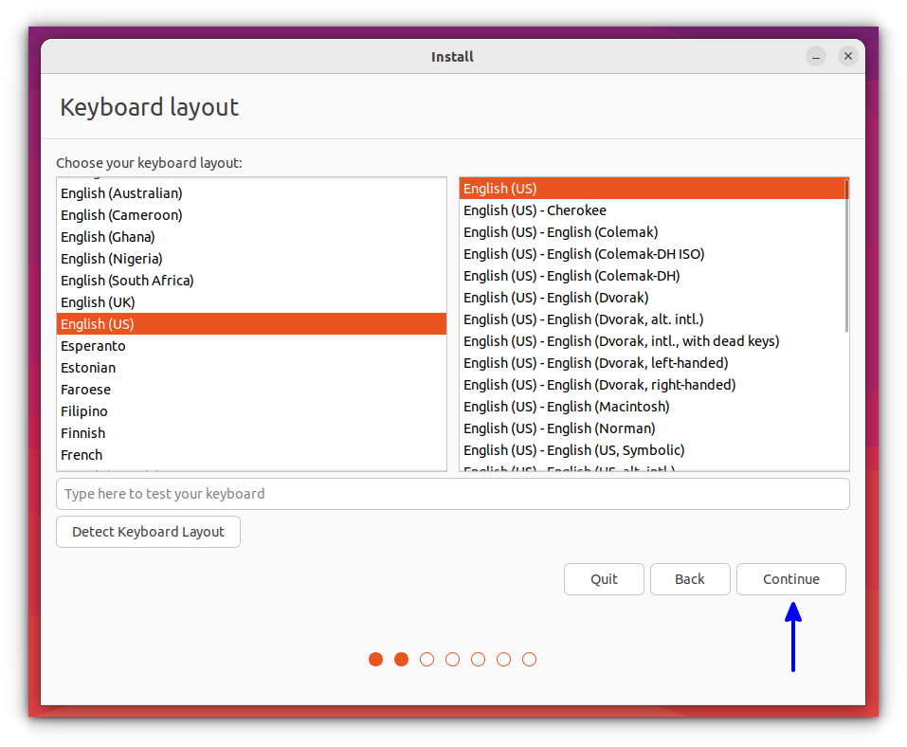
Select language
English US

Slide 30
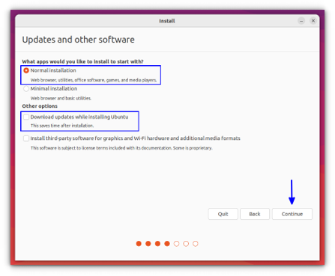
Normal installation
Download updates while installing Ubuntu

Slide 31
Set Up Your Sources List
First, set up your computer to accept software from the ROS repository. Open a terminal and run the following commands:
sudo sh -c 'echo "deb http://packages.ros.org/ros/ubuntu $(lsb_release -sc) main" > /etc/apt/sources.list.d/ros-latest.list'

Slide 32

Set Up Your Keys
Next, add the ROS key to your system to authenticate the packages. Run these commands:
sudo apt update
sudo apt install curl
sudo curl -sSL https://raw.githubusercontent.com/ros/rosdistro/master/ros.asc | sudo tee /etc/apt/trusted.gpg.d/ros.asc > /dev/null

Slide 33
Add ROS2 repository
echo "deb [arch=$(dpkg --print-architecture) signed-by=/etc/apt/trusted.gpg.d/ros.asc] http://packages.ros.org/ros2/ubuntu $(. /etc/os-release && echo $UBUNTU_CODENAME) main" | sudo tee /etc/apt/sources.list.d/ros2.list > /dev/null

Slide 34

Install ROS 2 Humble
sudo apt update
sudo apt install ros-humble-desktop -y
Source the ROS environment in every terminal:
source /opt/ros/humble/setup.bash
To make it permenant
echo "source /opt/ros/humble/setup.bash" >> ~/.bashrc
source ~/.bashrc
to install development tools
sudo apt install -y python3-colcon-common-extensions python3-rosdep python3-argcomplete
Initialize rosdepsudo rosdep init
rosdep update

Slide 35
Initialize ros dependencies
You'll need to initialize rosdep, which is a tool for managing package dependencies.
sudo rosdep init
rosdep update

Slide 36
Environment Setup
echo "source /opt/ros/humble/setup.bash" >> ~/.bashrc
source ~/.bashrc

Slide 37
Thank you

